Slide 1
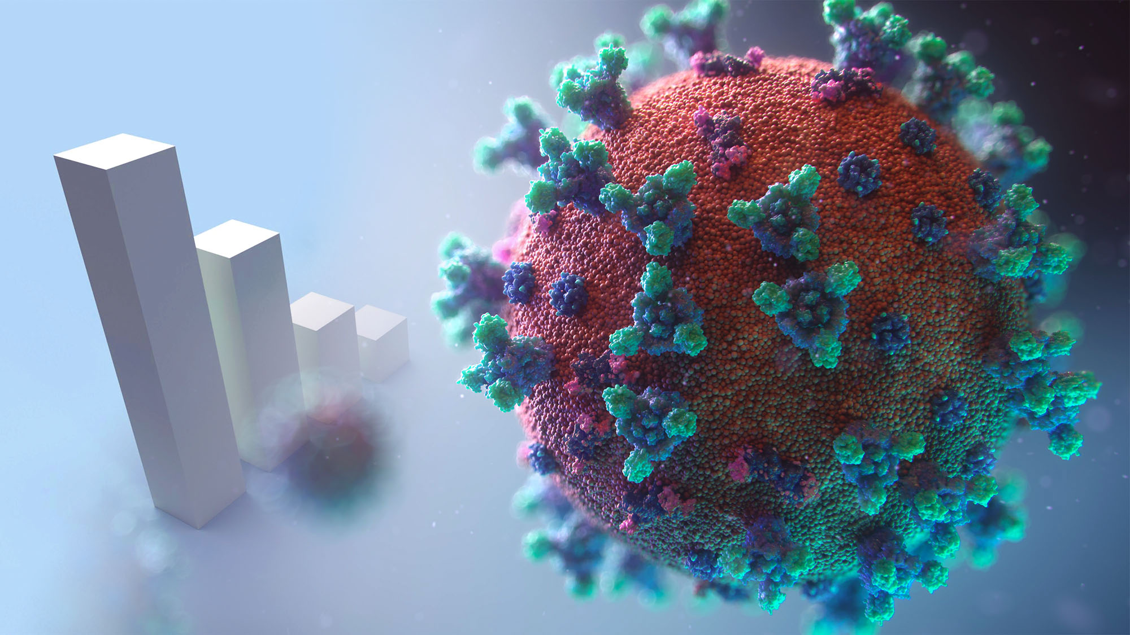
COVID Statistics
Death Rates and Cases Detected

Slide 2


Objective
The main reason behind the selection of this topic is to analyze the affected, cured and death ratio so that if these kind of viruses further spread in the future we may have better technologies and assets to fight against them.

Slide 3
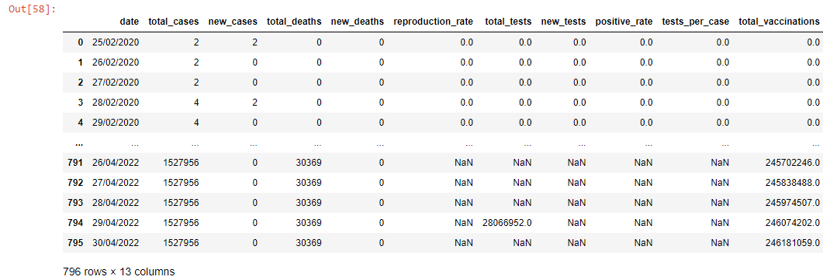
Sample Dataset

Slide 4


Dataset Source
Country Related to Dataset: Pakistan
Link to Dataset:
https://ourworldindata.org/coronavirus/country/pakistan

Slide 5
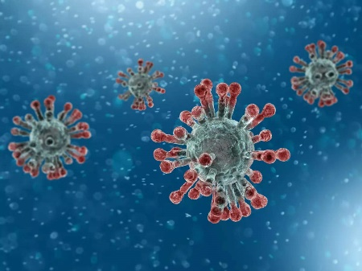



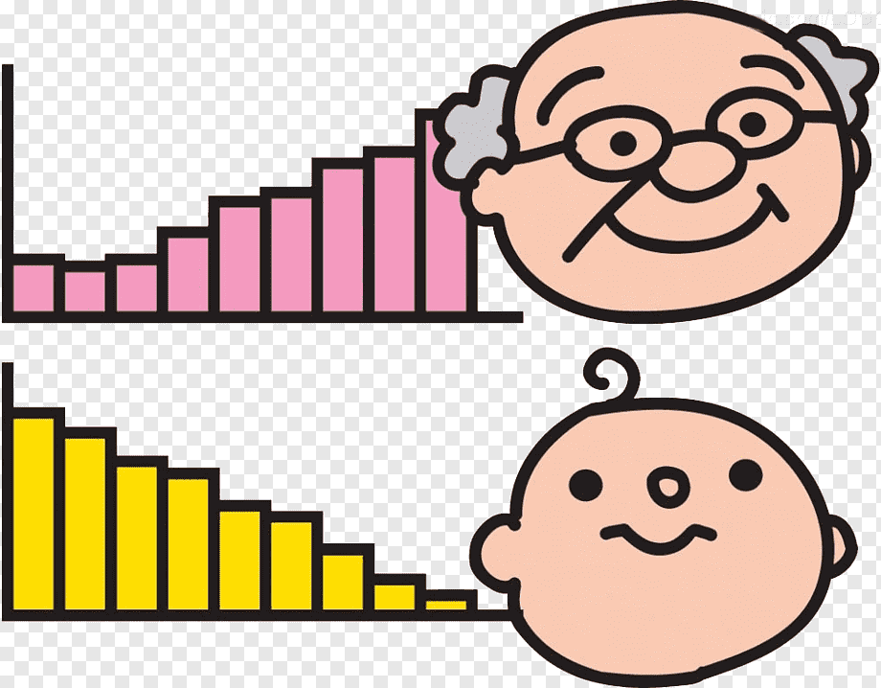

Variables Used
Total Cases
Cases
Total Deaths
New Deaths
Reproduction Rate
Total Tests

Slide 6
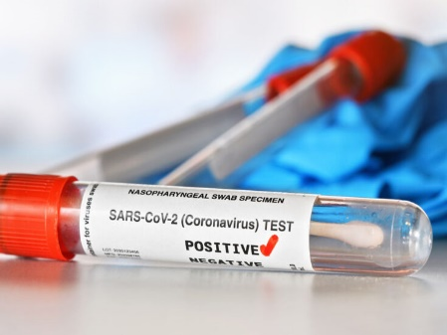

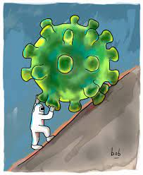
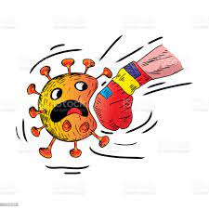
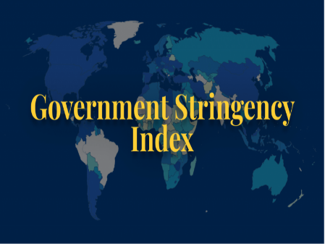
Variables Used
New Tests
Positivity Rate
Total Vaccines
New Vaccines
Stringency Index

Slide 7




Softwares Used

Slide 8

Group Members
Syed Muhammad Faheem 20K-1054
Ishaqullah Siddique 20K-0148
Sarim Latif Khan 20K-1644
Syed Muhib Ahmed 20K-0405

